Slide 1
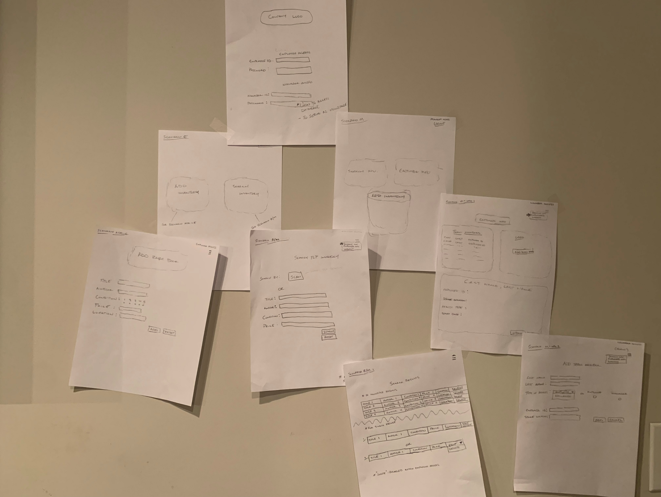
Notes:
Website Tree: Navigation snapshot of the website

Slide 2
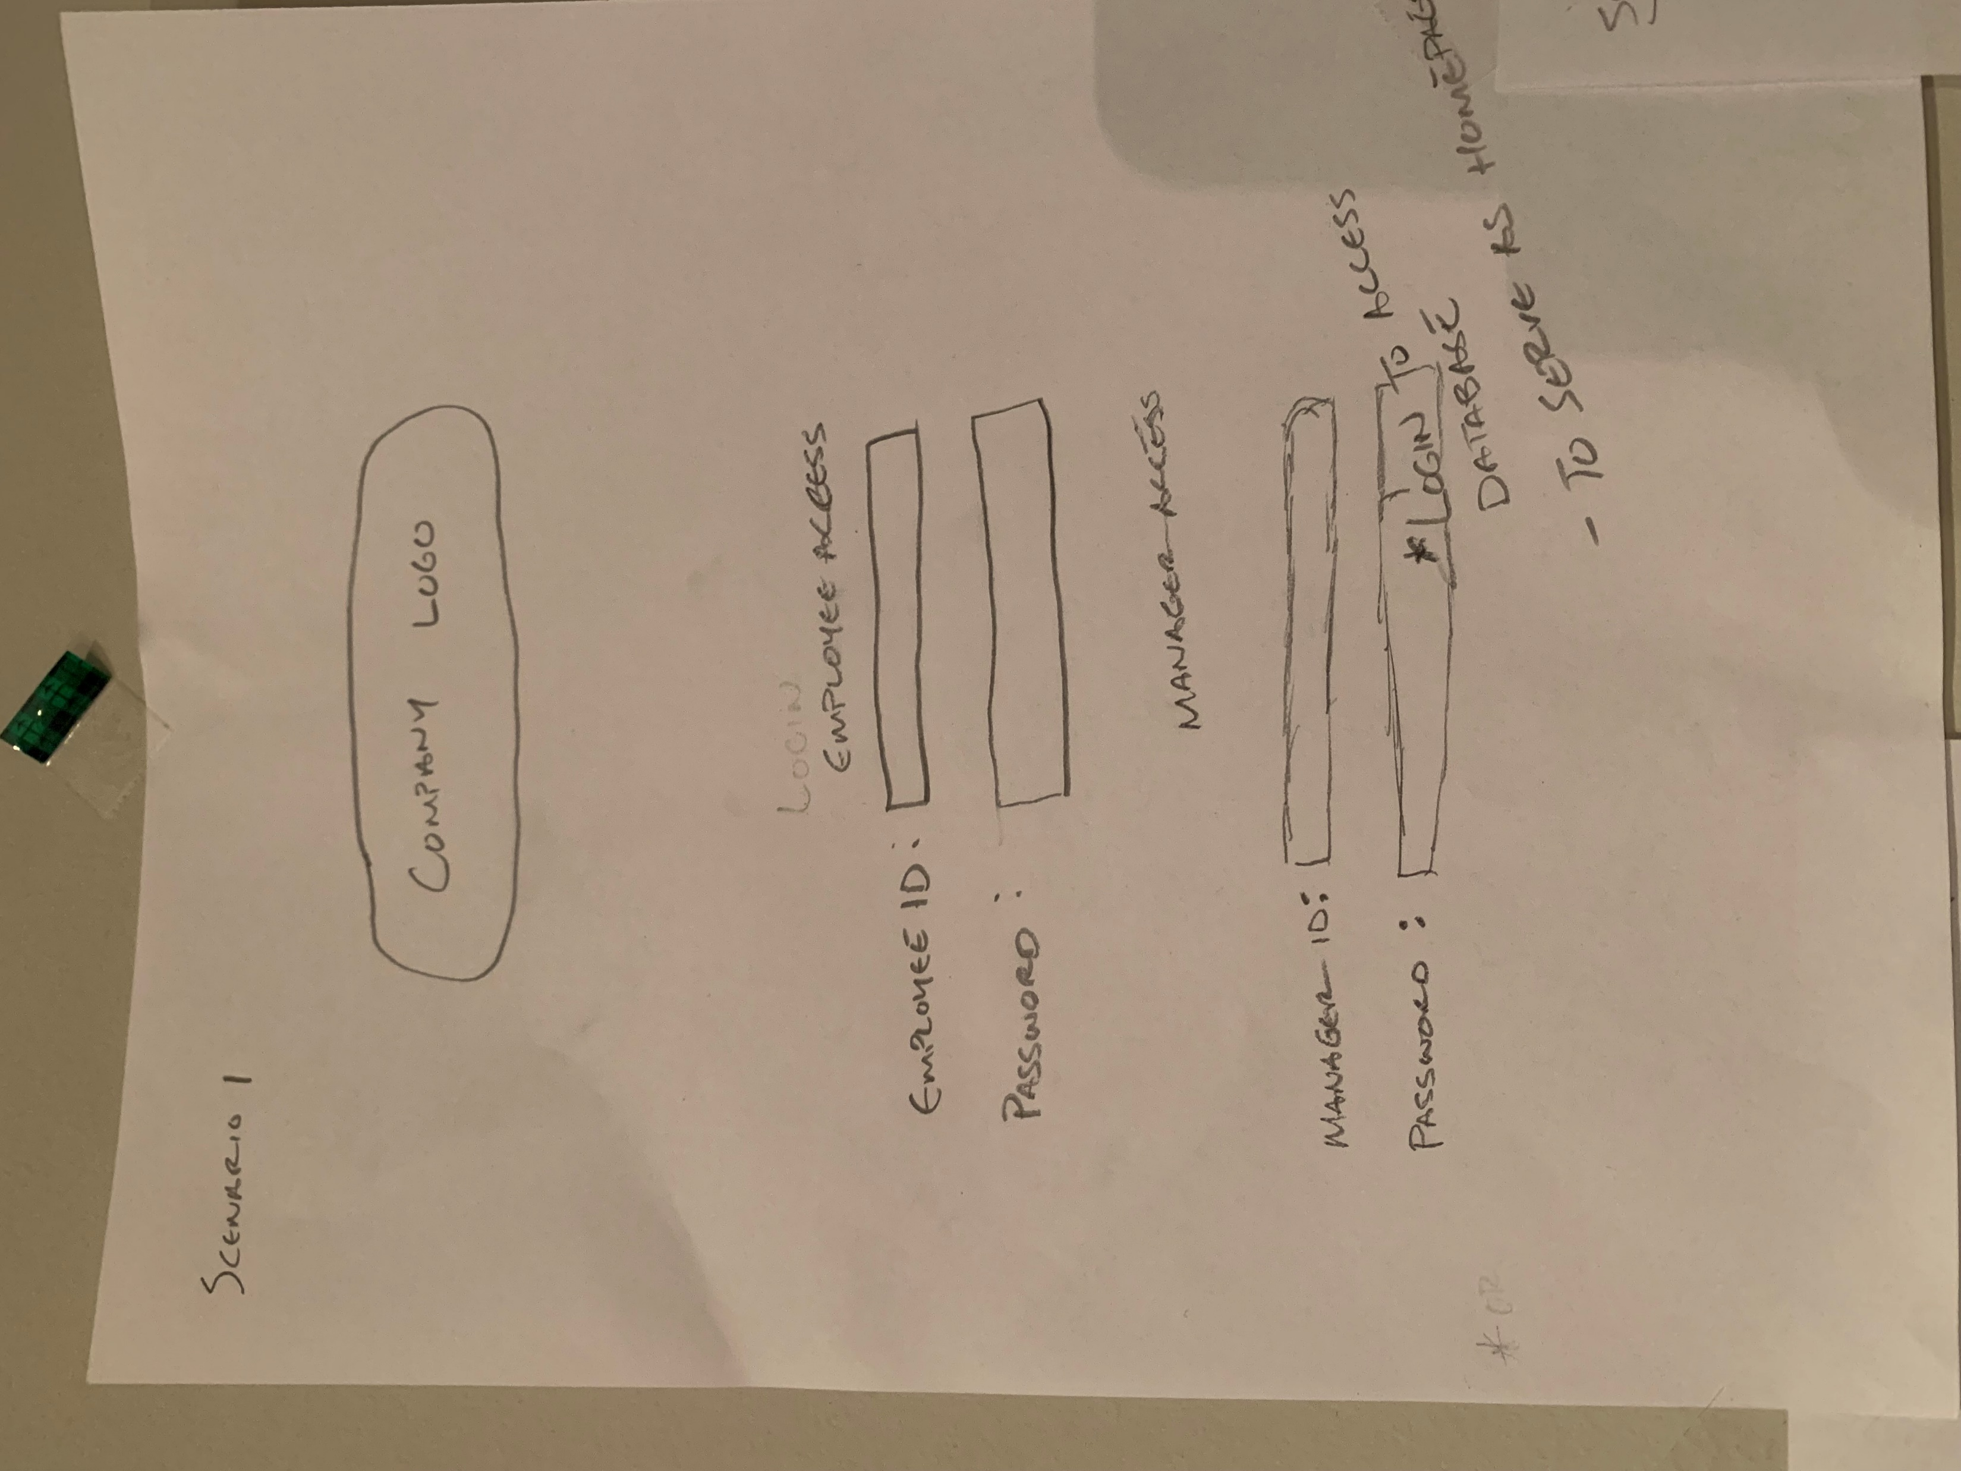
Notes:
Login page: to serve as homepage for all users
Contains textbox for “employee access” and “manager access”
1. Employee or manager will gain access to the system via username and password.
Type of access will be determined when team member is added to the system
Username may be first initial and last name with temp password to be changed after first login

Slide 3
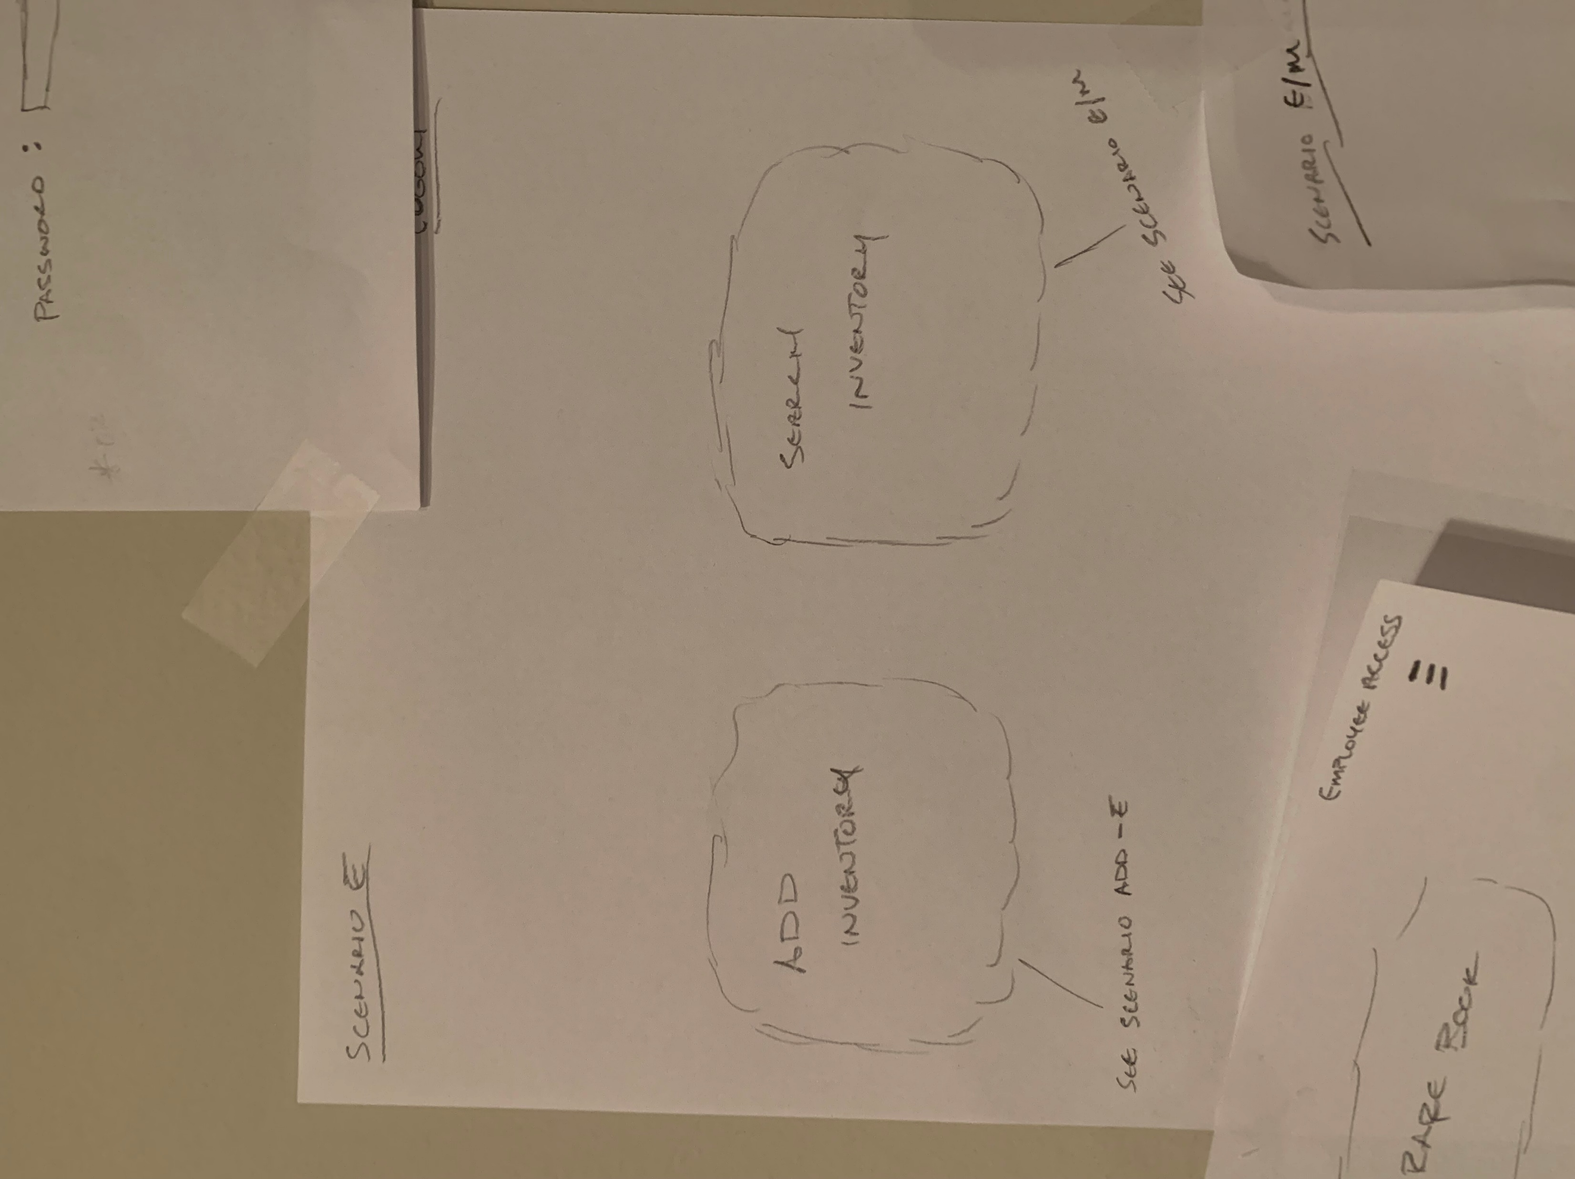
Notes:
Scenario E: Login through “employee access”
1. After login, this page will serve as a landing page after login
2 options
Add Inventory
Will use this option upon receiving a new book.
Search Inventory
Use this option to search inventory to view books or edit them.

Slide 4
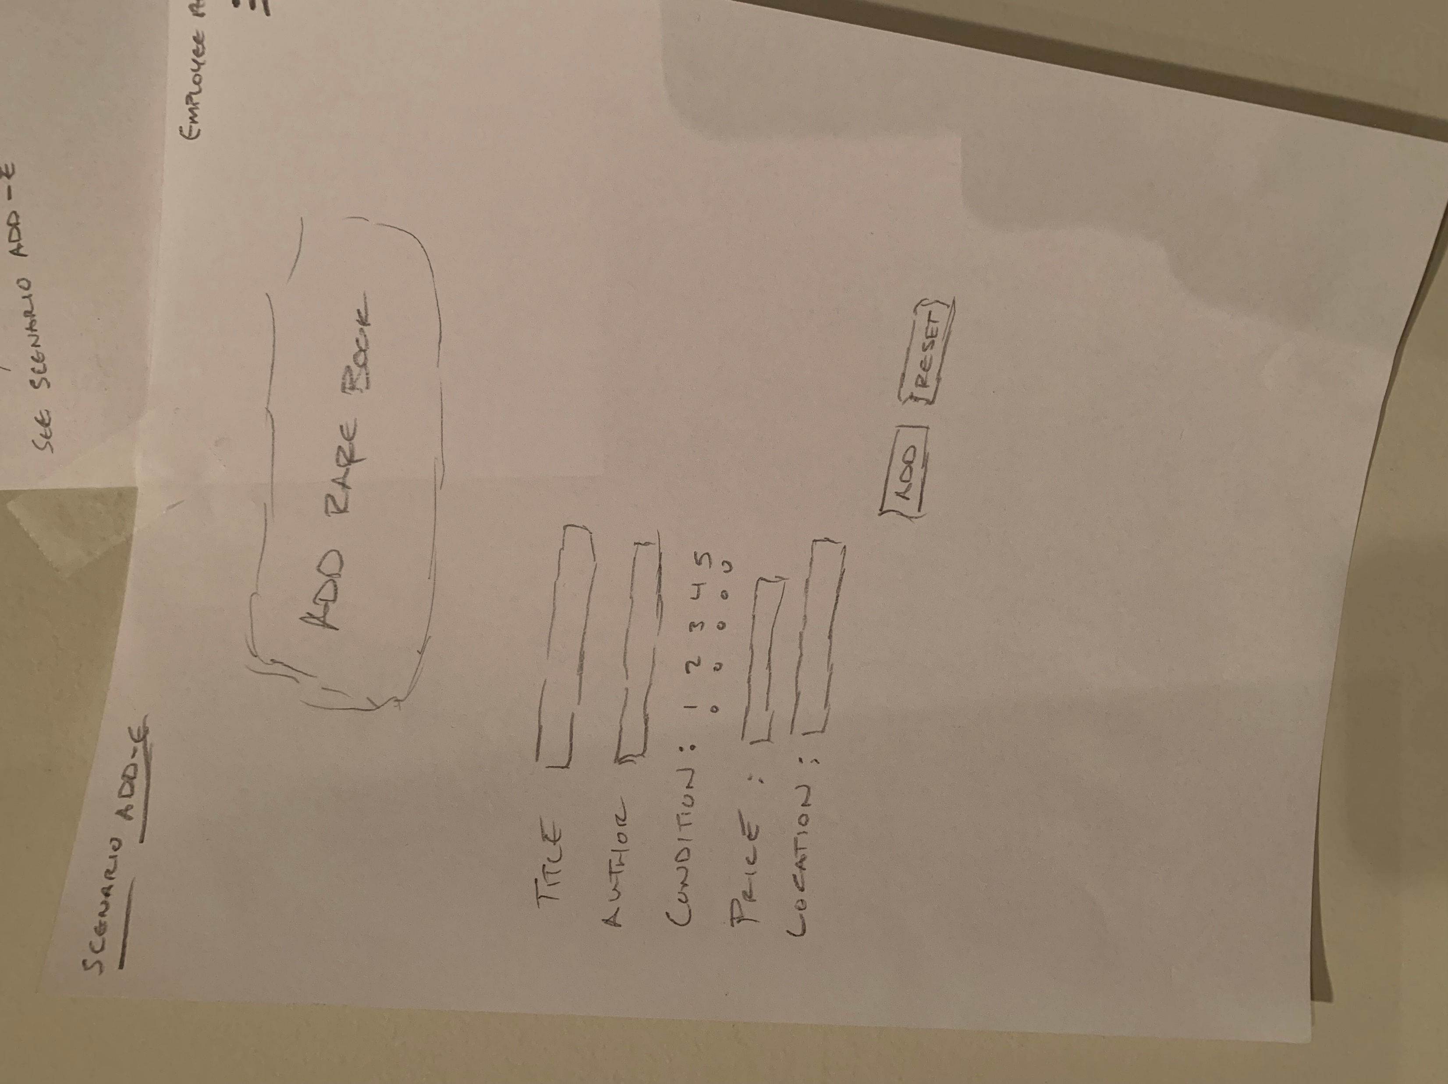
Notes:
Scenario E – Add inventory option
1. Once “Add Inventory” option is selected
Leads to a form to be completed
Contains fields for
Title
Author
Condition w/ radio buttons for ranking system
Price
Store Location
When fields are completed; select “Add” button to submit responses

Slide 5
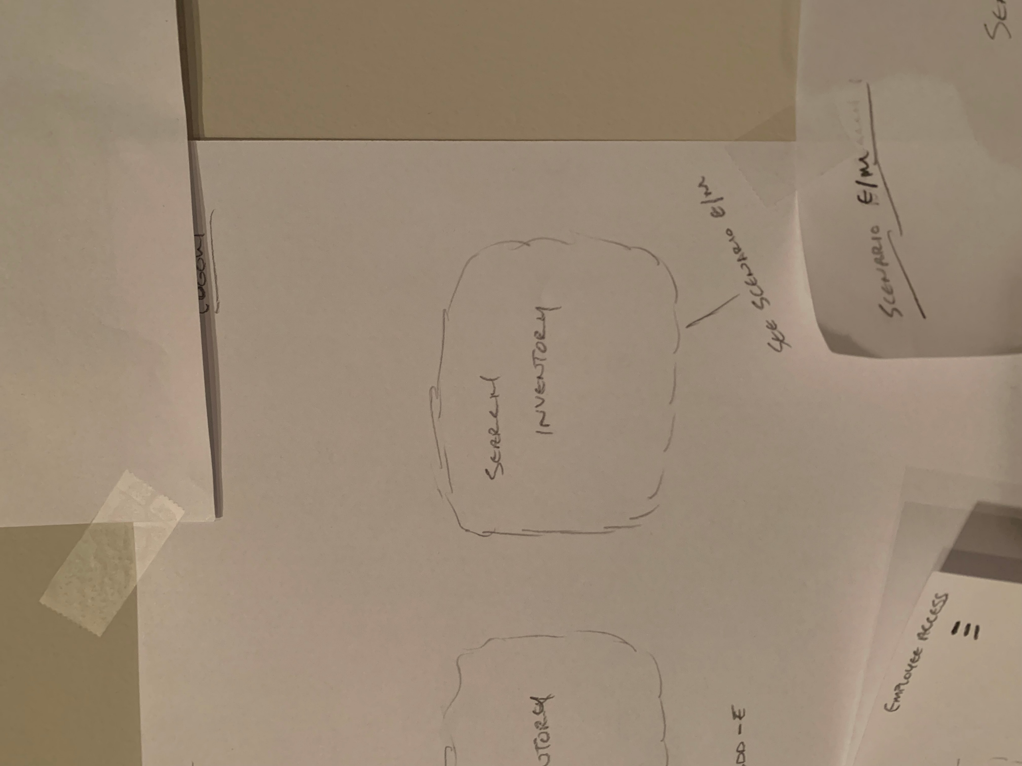
Notes:
Search Inventory Option
1. Using this option will lead to search engine (see next slide).

Slide 6
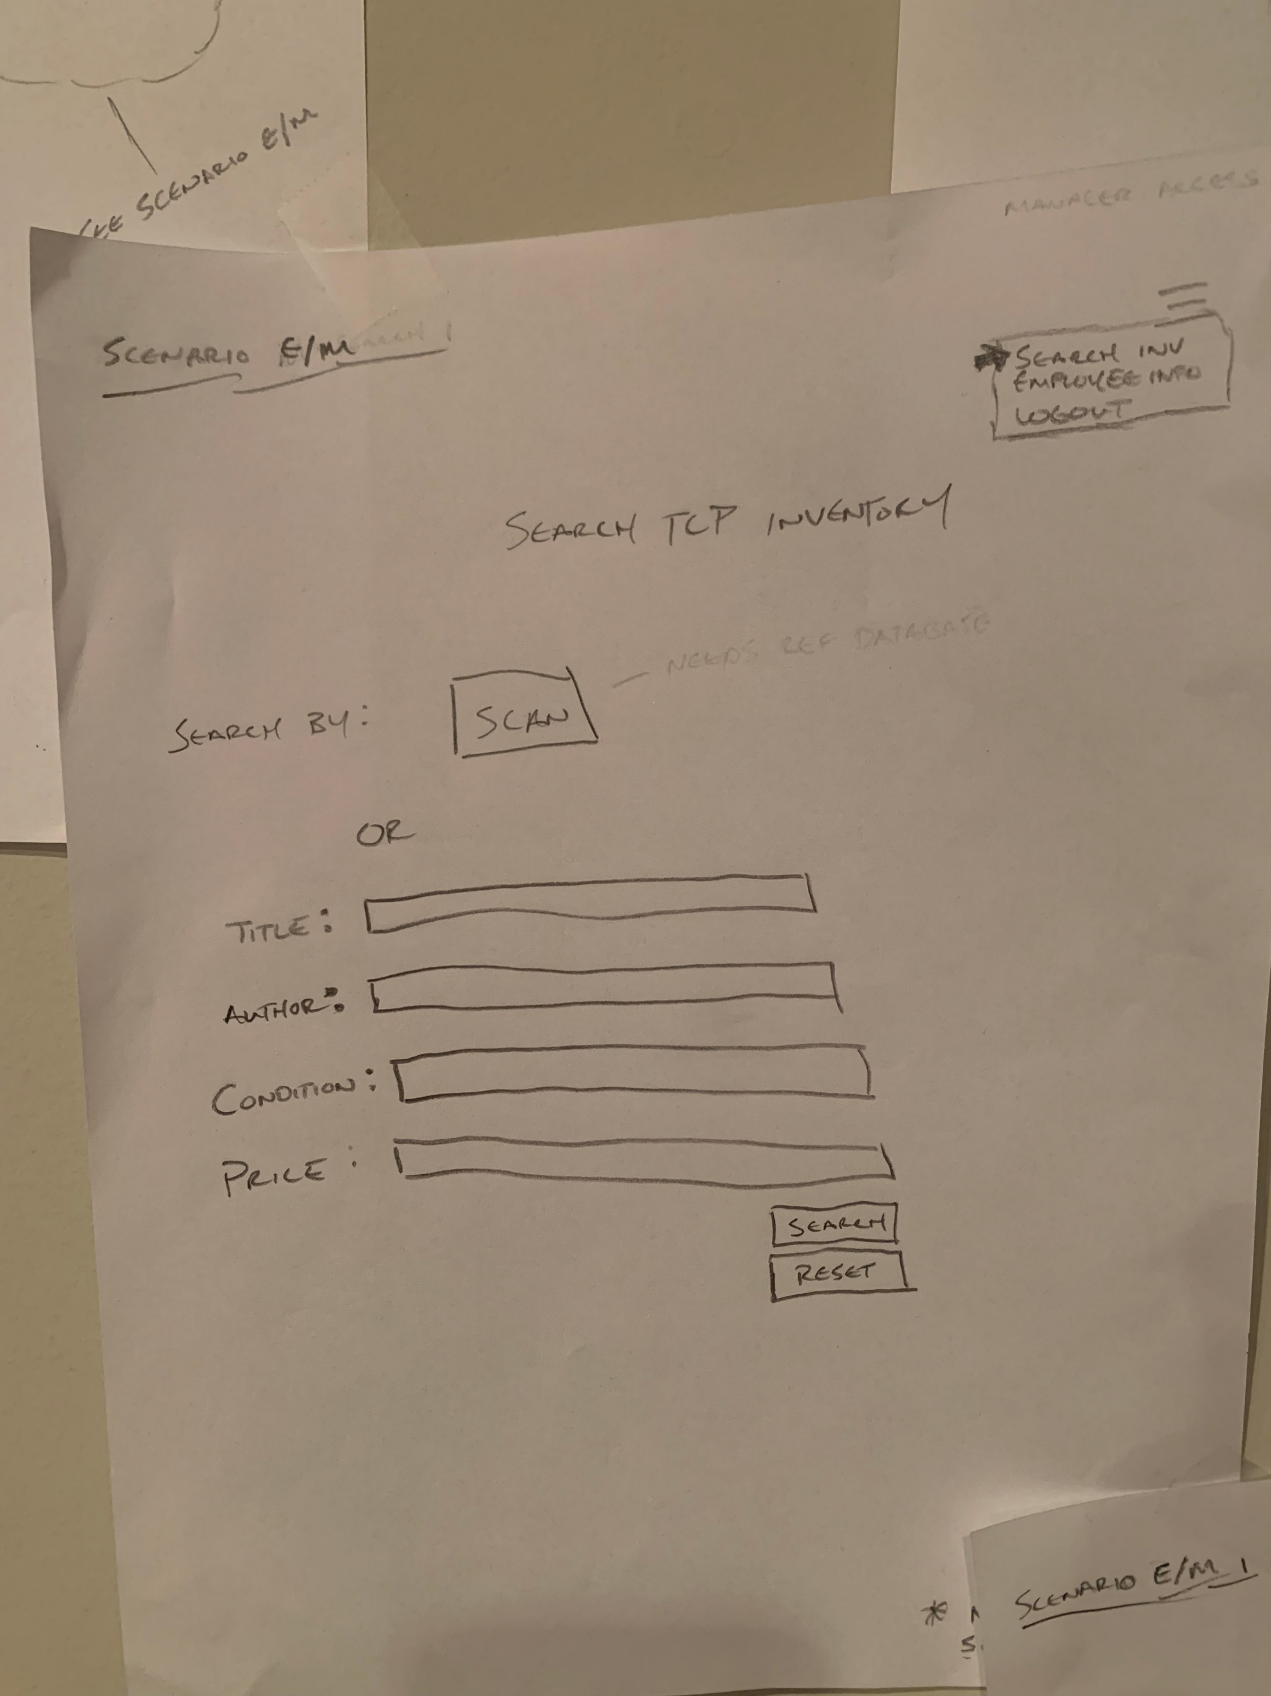
Notes:
Scenario E/M – Search Inventory Option
When selected leads here
2 search options
Scan barcode
If reference database is available
Manual search by filling in field(s)
Once manual fields are complete; submit by using “search” button
Reset button clears the fields

Slide 7
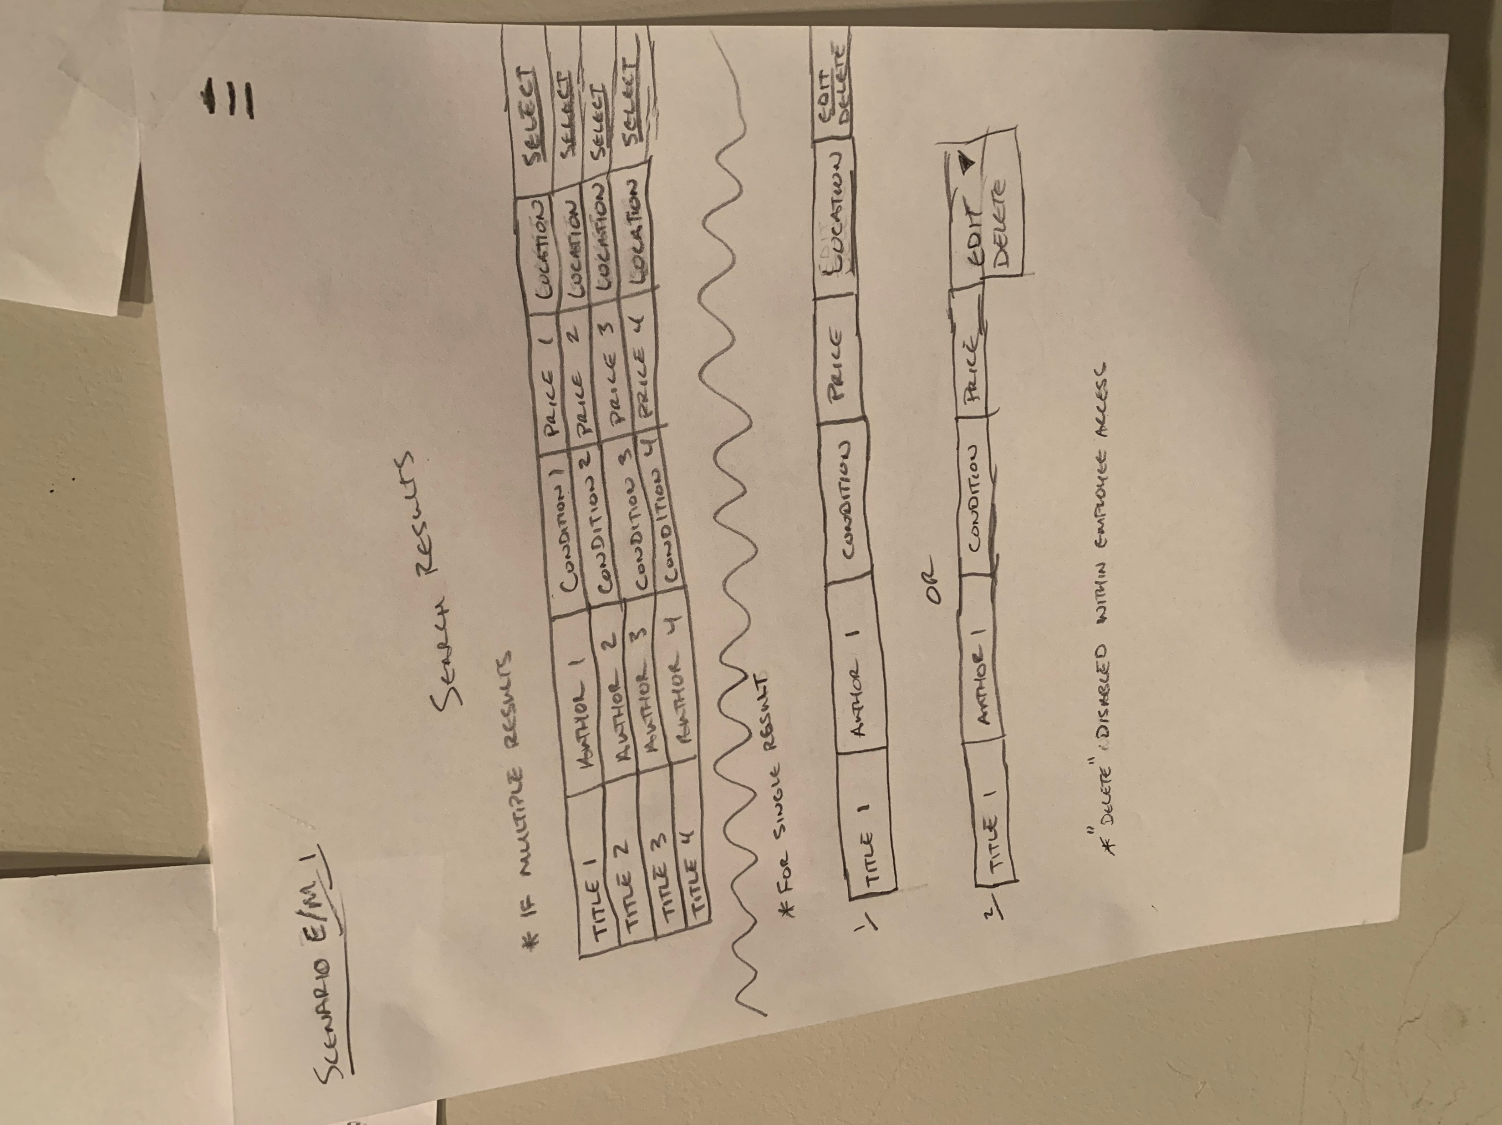
Notes:
Scenario E/M – Search inventory option
When search is initiated:
Multiple results
Gives a “select” option in the 6th column
Single result
Gives option for “edit” or “delete”
Delete option will be disabled in “employee access”

Slide 8
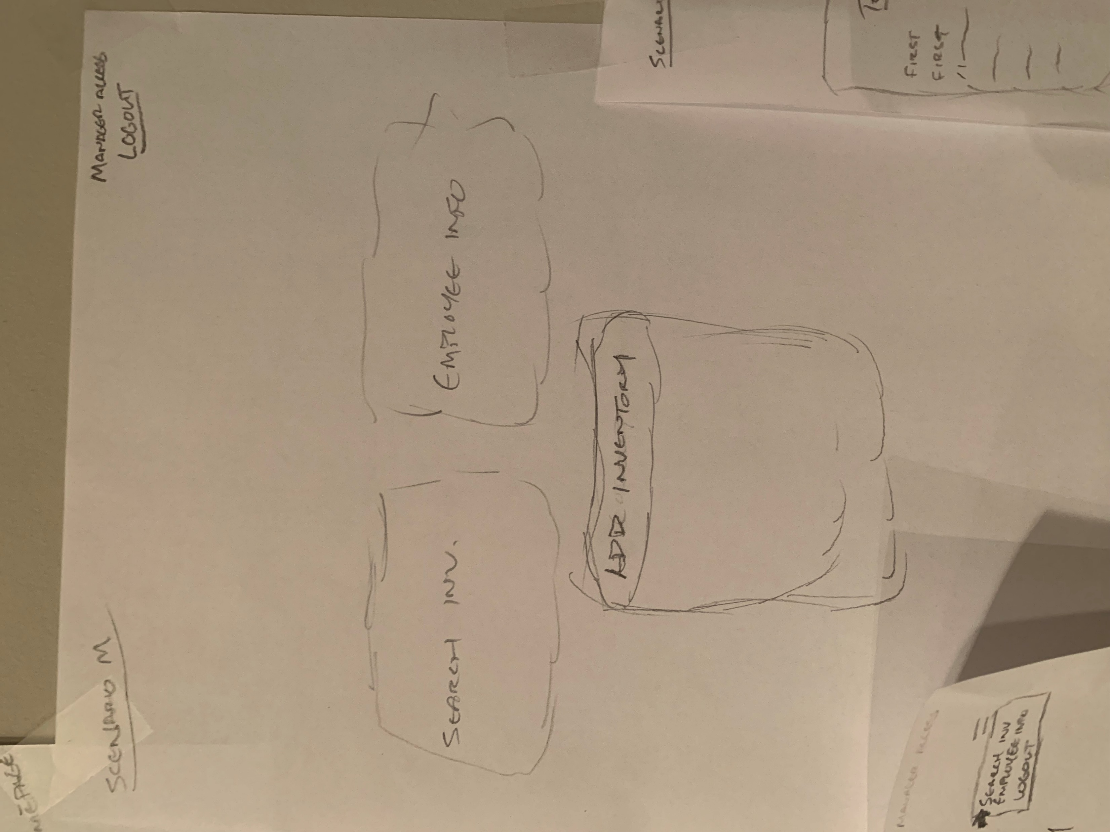
Notes:
Scenario M
Landing page for Managers/District Manager after login
Has the option to
Search Inventory (see slides 5-7 for Search Inventory option)
Add Inventory (see slides 3-4 for Add Inventory option)
Or go to Employee Information

Slide 9
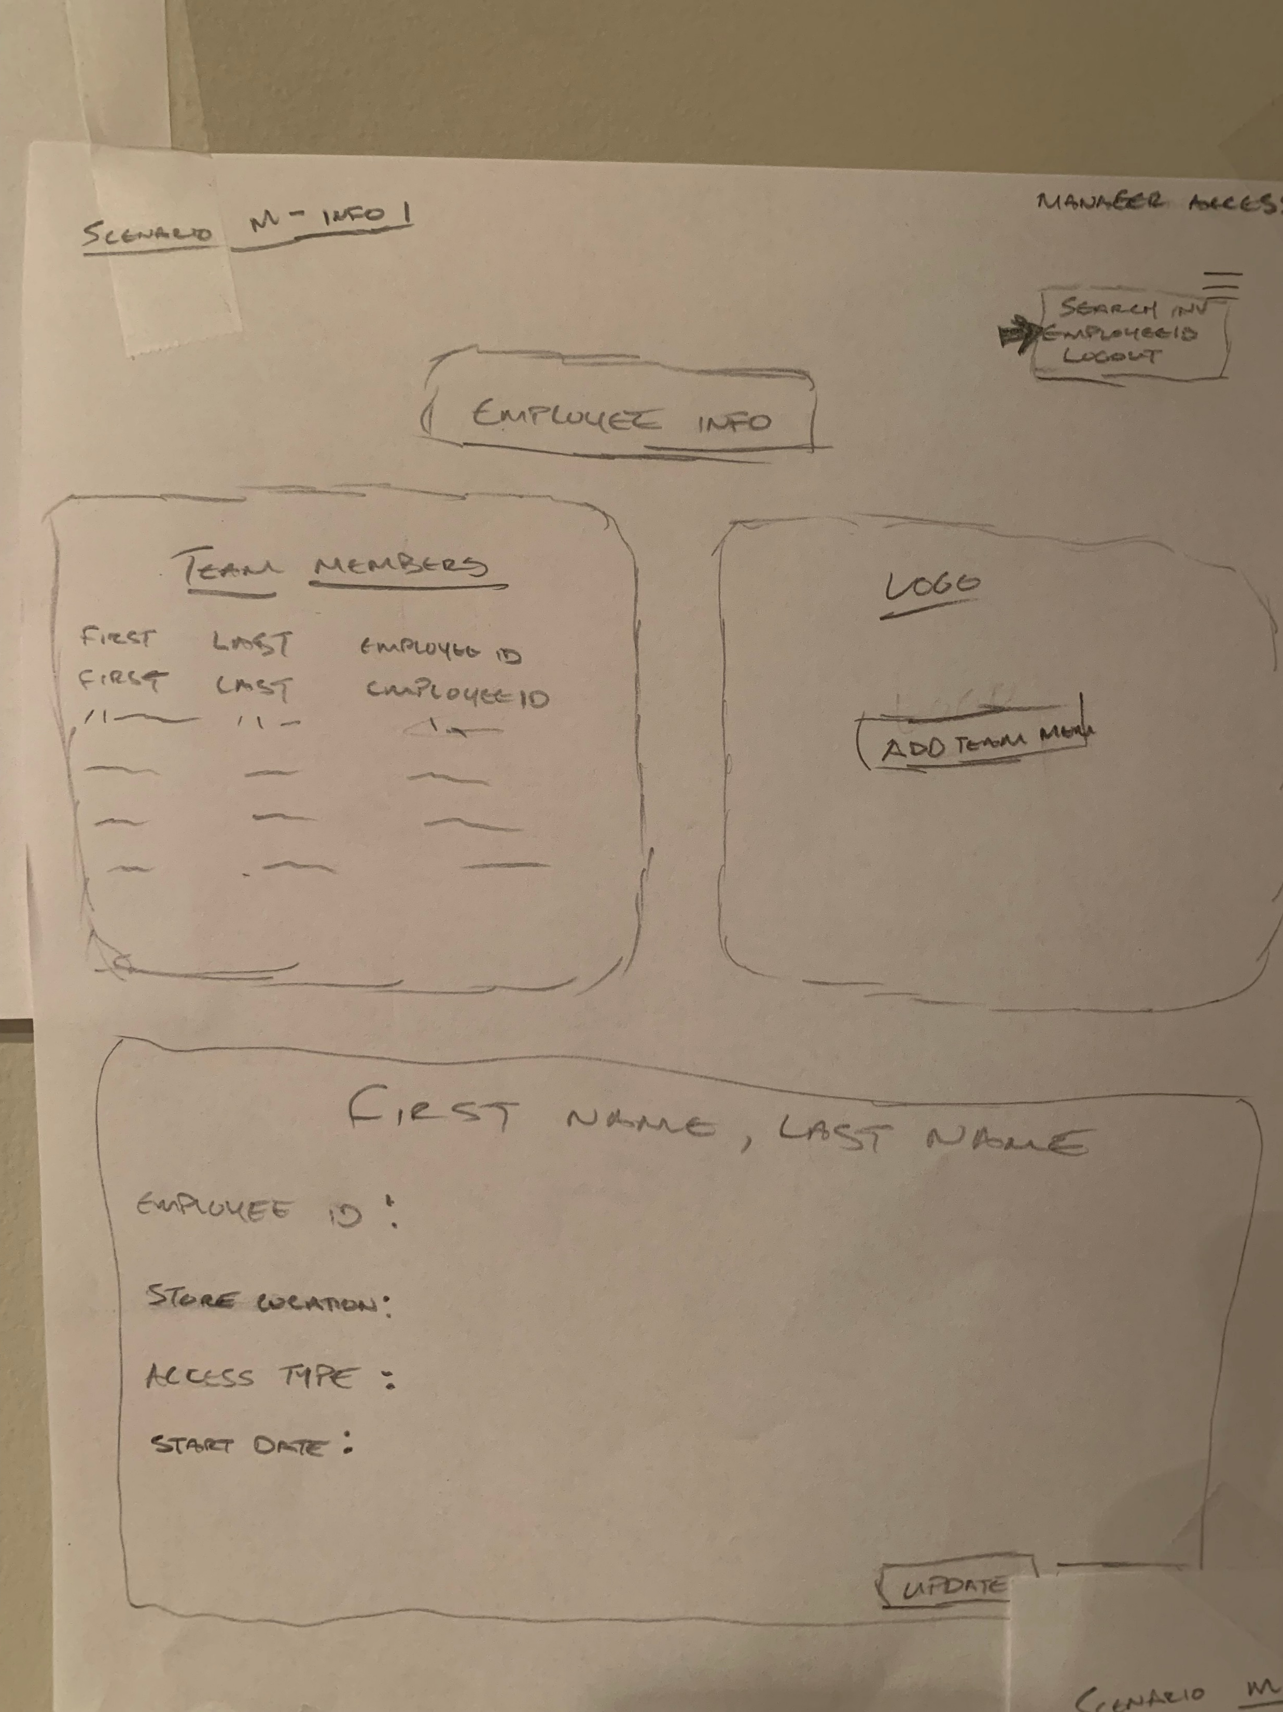
Notes:
Scenario M – Employee Info option
Landing page after “Employee Info” button is selected
This will have a complete list of users (top left)
Employee info will populate once selection is made (bottom)
Button to “add team member/user (top right)

Slide 10
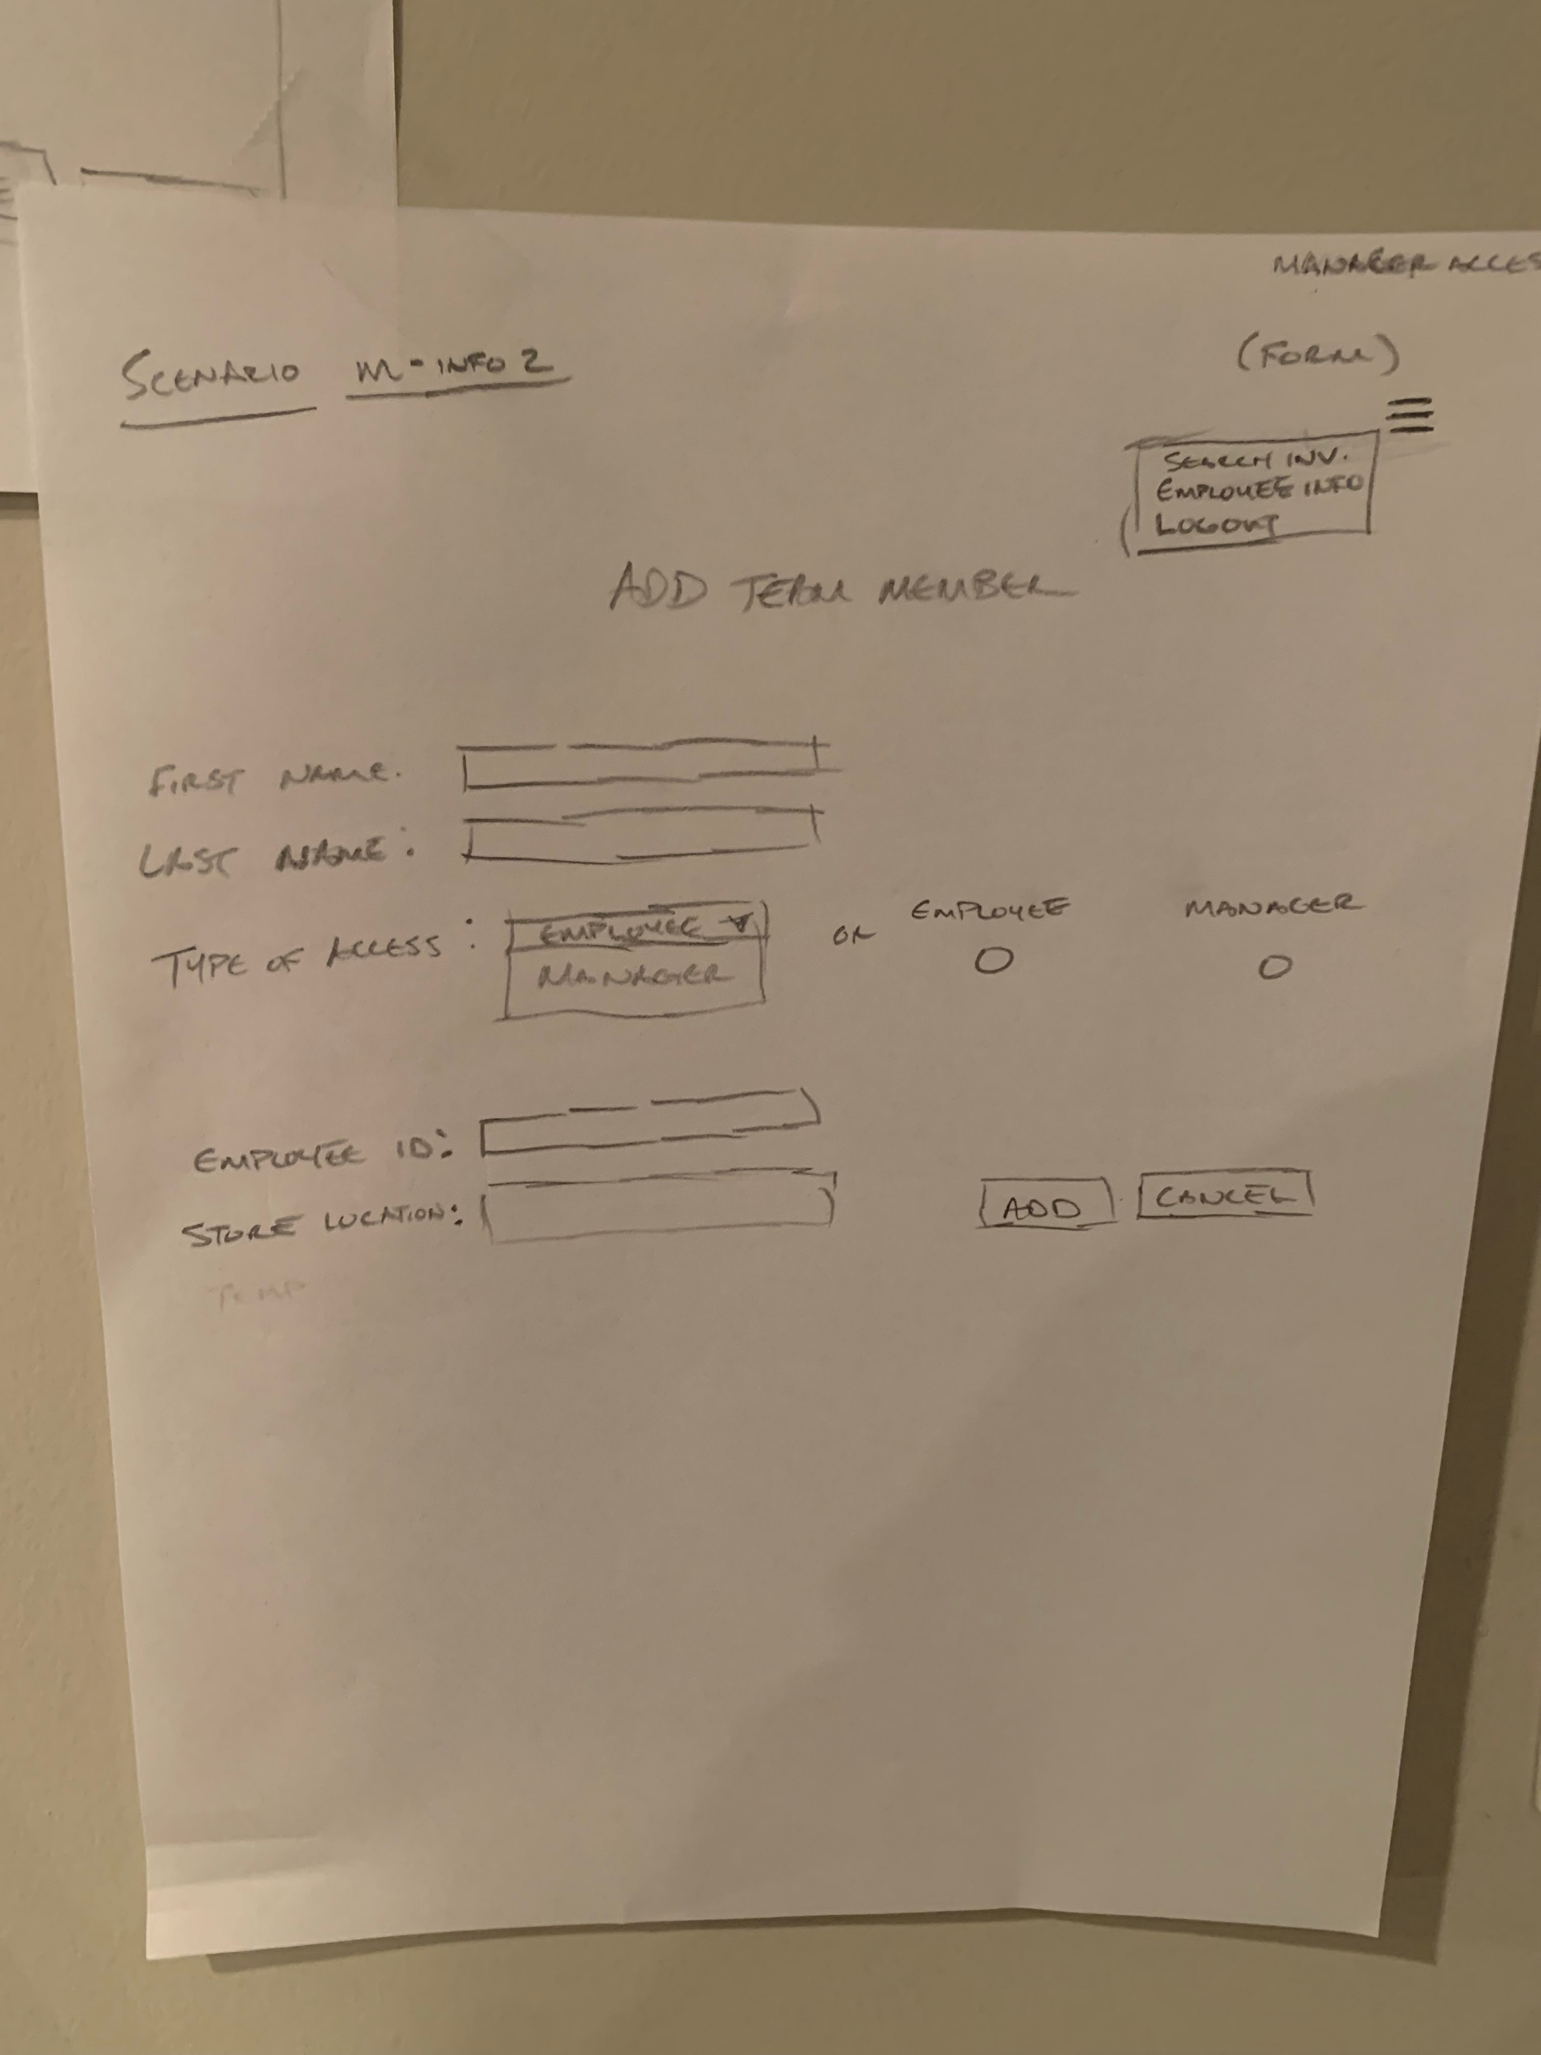
Notes:
Scenario M – Add Team Member option
Manager/District Manager form to add users to the system and determine their type of access
When button is selected to “add team member”; this form will render
Managers will be able to add information about the employee
Name
Type of access
Employee ID/Username
Home store location of employee
Select “Add” to submit information
Cancel to discontinue form

